Slide 1

Covid-19 Detection using CNN with X-ray images
by
Nandini K
Roll No. 184G1A0551
Gowtham Reddy B
Roll No. 184G1A0519
Bhavya sree A
Roll No. 184G1A0507
Jyothi A
Roll No. 184G1A0527
Under the guidance of
Dr . M. Ranjit Reddy _{M.Tech.,PhD.}
Professor
Department of Computer Science and Engineering
Srinivasa Ramanujan Institute of Technology
(Affiliated to JNTUA & Approved by AICTE) (Accredited by NAAC with ‘A’ Grade & Accredited by NBA (EEE, ECE & CSE)
Rotarypuram Village, B K Samudram Mandal, Ananthapuramu – 515701.
2021 - 2022

Slide 2
Abstract
For the novel Coronavirus, we have RT-PCR testing and many more.But there are several issues with RT-PCR testing like relying only one approach and delay in results. In search of alternative testing methodologies, so it’s not required to rely on just one approach.
Chest X-rays can be a great tool for detection of COVID-19. Once obtaining the chest X-rays of a person, by using Convolutional Neural Network (CNN), we can get the best results.

Slide 3
Review 0 Queries/Remarks
Where will you deploy your application?
We are going to deploy our application through a GUI.
Which algorithm are you going to use in this project?
Convolutional Neural Network.
What are you going to use in order to develop your GUI?
By using PyQt5 GUI toolkit.

Slide 4
Contents
Introduction
Existing System
Proposed System
Literature Survey
Problem Definition
Planning
Requirements
Architecture
Conclusion
References

Slide 5
Introduction
As we know that we had faced a lot of issues during pandemic. RT-PCR testing is the way on which we can find out whether a person is tested positive or not. But it takes a lot of time nearly 2-3 days for getting the results. In the meanwhile, a lot of problem may occur.
In search of alternative testing methodologies, we can go for X-ray images. Chest X-rays can be a great tool for detection of COVID-19. Once obtaining the chest X-rays of a person, a solution has been proposed to this problem by developing a COVID-19 detection system. Deep Learning techniques, especially Convolutional Neural Network (CNN) can be used for detection. And by using this technique we can able to know whether a person has covid or not.

Slide 6
Existing System
The novel Coronavirus has emerged as a pandemic and has raised many questions on health. This made public health emergency globally. The number of infected people and deaths are increasing day by day. This made tremendous pressure on our social and healthcare system.
One of the critical factors behind the rapid spread of Covid-19 pandemic is lengthy clinical testing time . Nearly RT-PCR testing takes 2-3 days of time for producing the results after the testing has been done.

Slide 7
Contd…
Types of tests available for Covid-19 detection:
RT-PCR:
also called a molecular test ,this test detects genetic material of virus using a lab technique . A health care professional collects a fluid sample by inserting a long swab into your nostril and taking fluid from back of your nose.In some cases you may need to spit into a tube to produce a saliva sample.
Antigen Test:
It detects certain proteins in the virus . There is an increased chance of false-negative result.
Rapid point-of-Care tests:
self tests can be taken at home or anywhere,are easy to use and produce rapid result . They are not that much accurate.

Slide 8
Proposed System
Image tool , such as Chest X-ray(CXR),can speed up the identification process . The objective is to develop Covid-19 detection system using CNN. Chest X-rays can be a great tool for detection of COVID-19. we can use Deep Learning techniques, especially Convolutional Neural Network (CNN) can be used for image classification.
Based upon the image of the X-ray, the image processing is done . Once obtaining the chest X-ray of a person’s image, a call has to be made on Covid-19 status for classification. By this, we can able to detect whether the person is infected with coronavirus or not. For getting the result whether positive or normal, a GUI is developed.

Slide 9
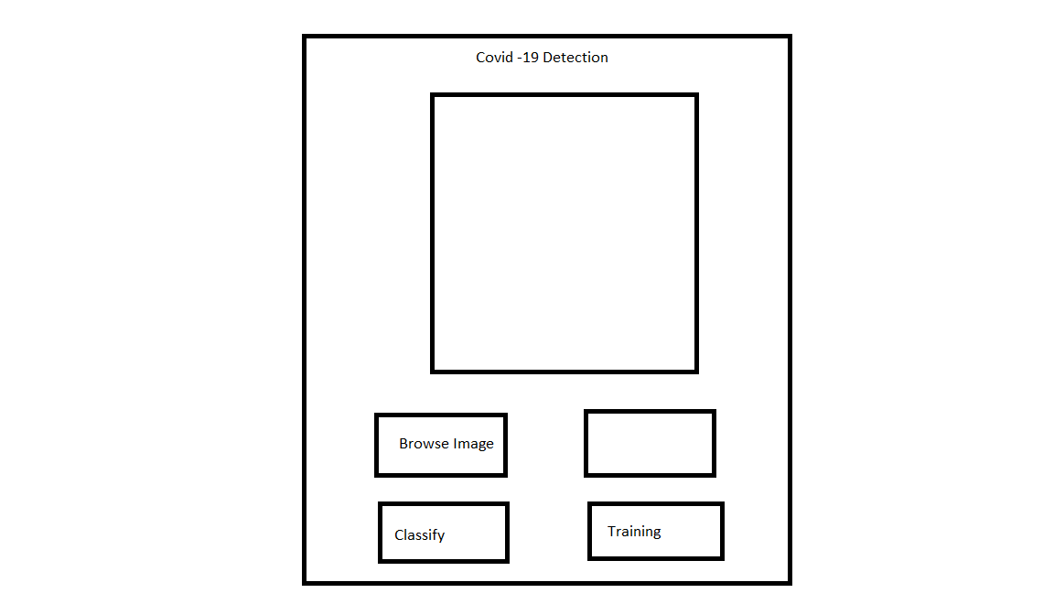
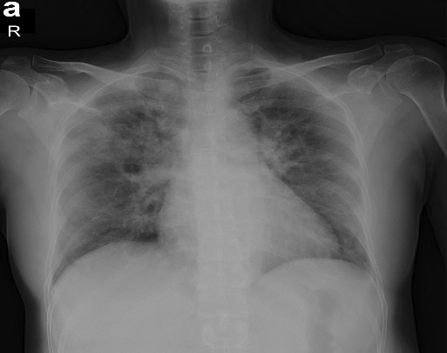
…contd

Slide 10
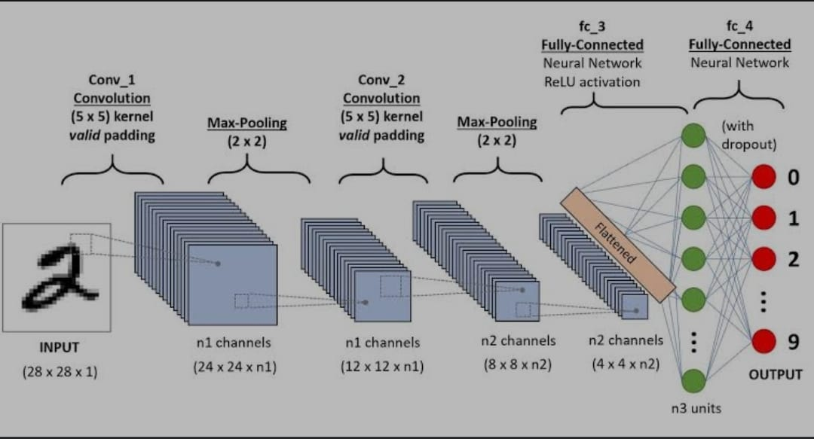
Contd….

Slide 11
Literature Survey
“A Deep Learning Approach for the Detection of COVID-19 from Chest X-Ray Images using Convolutional Neural Networks”[1]
Adithya Saxena -With limited number of COVID-19 test kits available in medical facilities . Chest X-ray is the first imaging technique that plays an important role in the diagnosis of COVID-19 disease. Computer vision and deep learning techniques can help in determining COVID-19 virus with Chest X-ray Images.
Gives binary output : Normal and Covid. The performance of the model is compared with four pre-trained CNN based model.
Covid-Net , ResNet18,ResNet , MobileNet-V2

Slide 12
Contd…
“COVID-19 diagnosis from CT scans and chest X-ray images”[2]
The diagnosis of COVID-19 is of vital demand. Several studies have been conducted to decide whether the chest X-ray and computed tomography (CT) scans of patients indicate COVID-19. While these efforts resulted in successful classification systems, the design of a portable and cost-effective COVID-19 diagnosis system has not been addressed yet. The memory requirements of the current state-of-the-art COVID-19 diagnosis systems are not suitable for embedded systems due to the required large memory size of these systems.
Local features are extracted using Local Binary Pattern[LBP]
Global features are extracted from Chest X-ray or CT scan.

Slide 13
Contd…
“COVID-19 Detection in X-ray Images using CNN Algorithm”[3]
In this research, we seek to prove the feasibility of applying a deep learning algorithm in early detection of infection with the Coronavirus and to determine whether using the algorithm could lead to the development of an accurate computer-based method to help doctors to identify COVID-19 patients by using x-ray images.
CheXNet Algorithm was developed to diagnose and detect pneumonia from Chest X-rays . They collected 550 chest X-ray images from Kaggle website and applied CNN Algorithm.

Slide 14
Problem Definition
COVID-19 global pandemic affects health care and lifestyle worldwide, and its early detection is critical to control cases spreading and mortality. The actual leader diagnosis test is the Reverse transcription Polymerase chain reaction (RT-PCR), result times and cost of these tests are high, so other fast and accessible diagnostic tools are needed. Inspired by recent research that correlates the presence of COVID-19 to findings in Chest X-ray images.
The proposed system will work in an efficient manner . The system has a user friendly GUI and platform independent base to work on to it . Through this proposed system we can able to classify whether a person is infected with corona virus or not in an easy way.

Slide 15
Planning
S.NO | WEEKS | TASK
1. | WEEK 1 | Downloading and installing softwares
2. | WEEK 2 | Data including and presentation on dataset
3. | WEEK 3 | Develop a model
4. | WEEK 4 | Develop a GUI for our model
5. | WEEK 5 | Test the model

Slide 16
Requirements
Operating System : Windows 10/11
Language : Python
Platform : Jupyter Notebook or IDLE
Libraries : Keras,Numpy,Scipy,PyQt5

Slide 17
Review_1 Remarks
What is padding?
Amount of pixels added to an image when it is being processed by kernel of CNN.
What is Pixel normalization?
It is a process that changes the range of pixel intensity value.
What is pooling?
In order to reduce the computational power required to process the data we use pooling.

Slide 18



Architecture
Positive
preprocess
negative
positive
preprocess
frontal
Multiply with image
preprocess
negative

Slide 19
UML Activity Diagram
X-ray Image
Pre Process
Decision
Training and Testing
positive or negative

Slide 20
Implementation
Modules:
Main Function
UI-Mainwindow
Retranslate UI
Load Image
Training Function
Classify Function
Libraries used:
Keras, Scipy ,sklearn,opencv,numpy,PyQt5

Slide 21
Sample Code
Main Function:
Here we will describe all the functions that are needed For our implementation.
if __name__ == "__main__":
import sys
app = QtWidgets.QApplication(sys.argv)
MainWindow = QtWidgets.QMainWindow()
ui = Ui_MainWindow()
ui.setupUi(MainWindow)
MainWindow.show()
sys.exit(app.exec_())

Slide 22
Contd…
UI-Mainwindow:
This module we will design the UI that is needed for our application . This consists of the fields like load image , training ,classify , and field to display the output . As it is difficult to write code by using various tools we have used PyQt5 designer tool .This is a type of a tool where we can just drag and drop the fields that are required.
This also contains the code which refers to the related functions as shown below:
self.BrowseImage.clicked.connect(self.loadImage)
self.Classify.clicked.connect(self.classifyFunction)
self.Training.clicked.connect(self.trainingFunction)

Slide 23
Contd…
Retranslate UI:
This module describes the text that is needed to be displayed on the fields in the GUI .
Load Image:
This function describes how to load a image from our device through folders present in our device.
Training Function:
This module involves the training .Here the input is feeded to neural network Pooling is done in this layer.
Classify Function:
This module describes classification .Based upon the image that is browsed and output is given whether a person is covid positive or not.

Slide 24
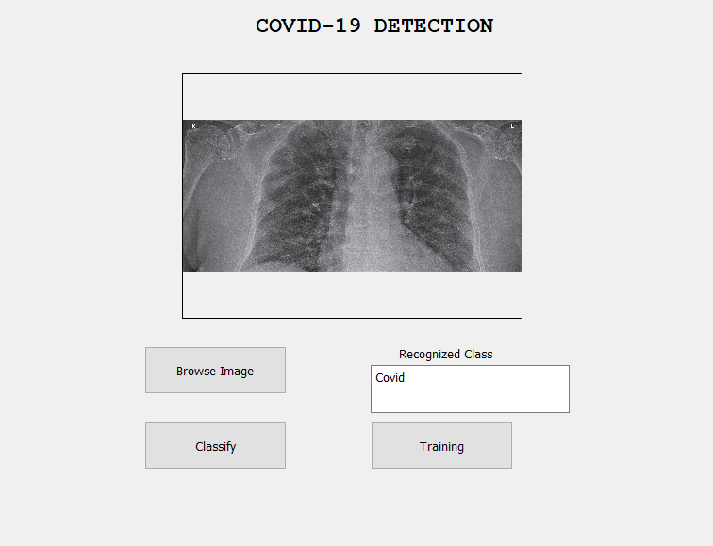
Output

Slide 25
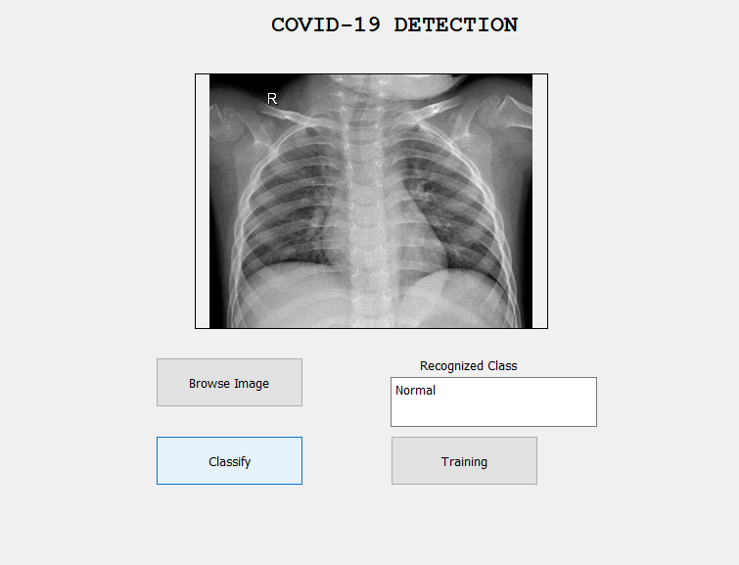
Contd….

Slide 26
Conclusion
The In this paper, we proposed CNN based deep learning model to find the results of a person whether he tests Positive or Normal. This achieved promising results on a small prepared dataset which indicates that given more data, the proposed model can achieve better results with minimum pre-processing of data. Overall, the proposed model substantially advances the current radiology based methodology and during COVID-19 pandemic, it can be very helpful tool for clinical practitioners and radiologists to aid them in diagnosis, quantification and follow-up of COVID-19 cases.

Slide 27
References
[1].Md Mamunur Rahaman ,Identification of COVID-19 samples from chest X-ray images using deep learning , Free PMC article.
https://pubmed.ncbi.nlm.nih.gov/32773400/
[2].Daniel Arias, “Covid-19 detection using convolution neural networks , Science Direct”
https://www.sciencedirect.com/science/article/pii/S2666827021000694

Slide 28
Suggestions/Queries please
Thank You!!!

